Slide 1









Slide 2


Welcome to OneCon25
Singularity™ Hyperautomation

Slide 3
Session Agenda
Hyperautomation Overview
Fundamentals of Hyperautomation
Workflow Use Cases

Slide 4
Safe Harbor
This presentation contains forward-looking statements of SentinelOne, Inc. (“SentinelOne” or the “Company”), within the meaning of Section 27A of the Securities Act of 1933, as amended, and Section 21E of the Securities Exchange Act of 1934, as amended, which statements involve risks and uncertainties, including statements regarding our future growth, and future financial and operating performance, competition and our competitive position, technological capabilities and strategic relationships, future product releases or capabilities, business strategy and our ability to execute our business plans, the COVID-19 pandemic, our reputation and performance in the market, general market trends, outstanding shares, market growth, and our objectives are forward-looking statements. The words “believe,” “may,” “will,” “potentially,” “estimate,” “continue,” “anticipate,” “intend,” “could,” “would,” “project,” “target,” “plan,” “expect,” or the negative of these terms and similar expressions are intended to identify forward-looking statements. However, not all forward-looking statements contain these identifying words. Forward-looking statements should not be read as a guarantee of future performance or results and will not necessarily be accurate indications of the times at, or by, which such performance or results will be achieved, if at all.
Forward-looking statements are based on information available at the time those statements are made and/or management’s good faith beliefs and assumptions as of that time with respect to future events, and are subject to risks and uncertainties that could cause actual performance or results to differ materially from those expressed in or suggested by the forward looking statements. In light of these risks and uncertainties, the forward-looking events and circumstances discussed in this presentation may not occur and actual results could differ materially from those anticipated or implied in the forward-looking statements. These risks and uncertainties are described in greater detail under the headings “Risk Factors” and “Management’s Discussion and Analysis of Financial Condition and Results of Operations” in the filings we make with the Securities and Exchange Commission (“SEC”) from time to time, which are available on our website at http://investors.SentinelOne.com and on the SEC’s website at www.sec.gov.

Slide 5

Shawn Stugart
Staff Technical Content Developer
SentinelOne
shawn.stugart@sentinelone.com

Slide 6
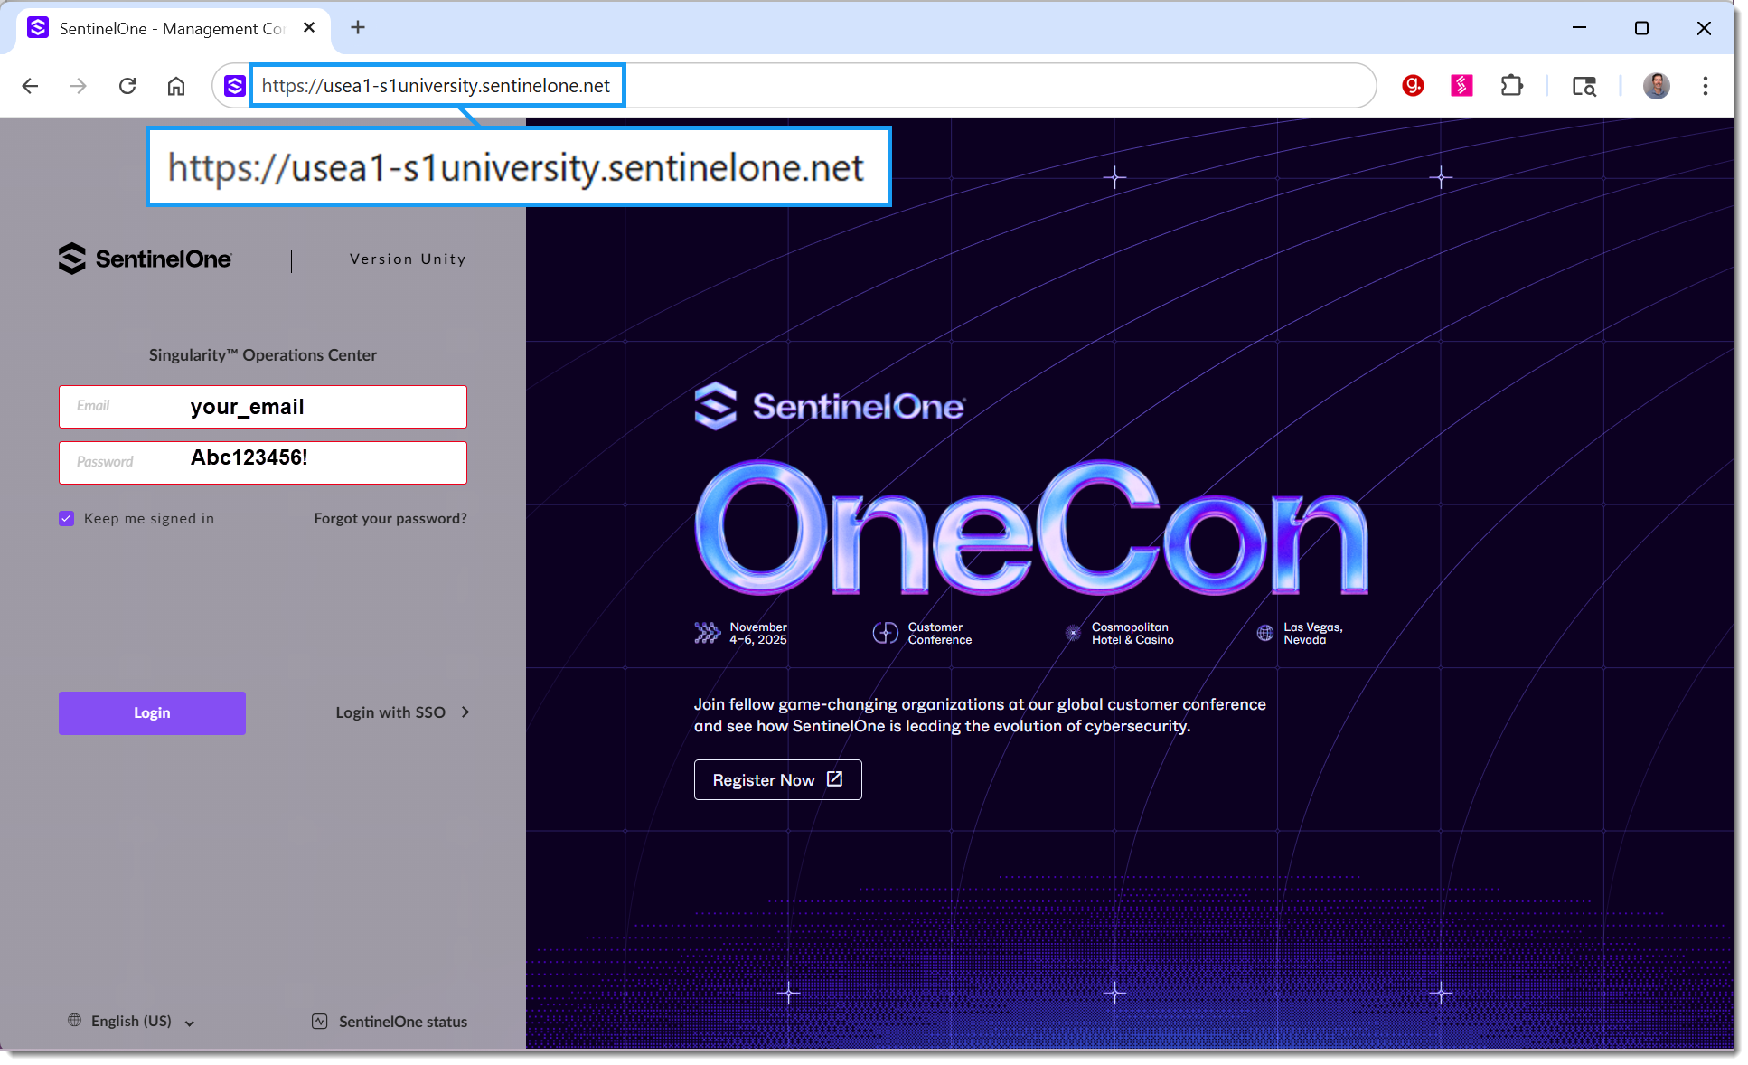

Slide 7
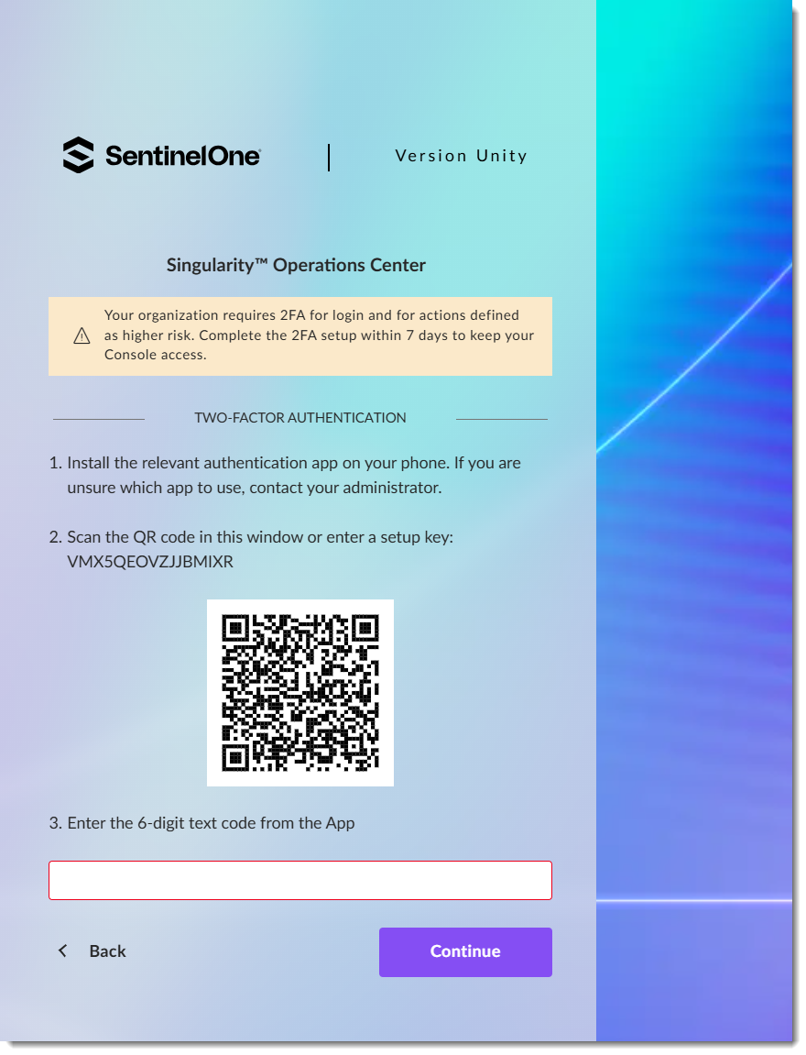
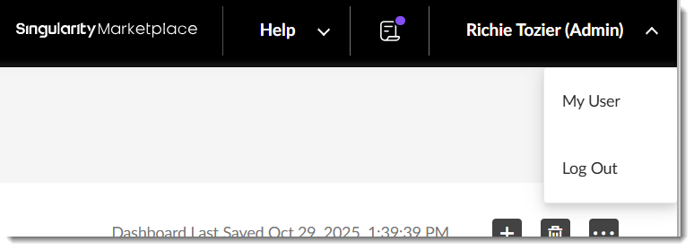
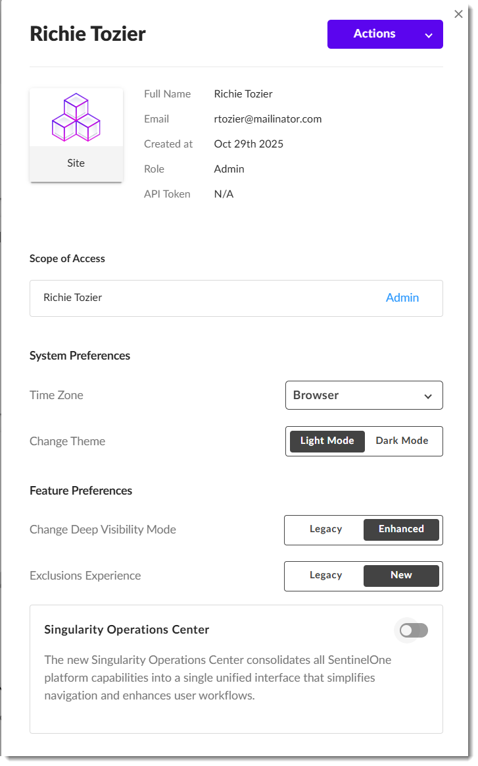

Slide 8

Hyperautomation Overview

Slide 9
Analyst Overload
Respondents to a recent 451 Research study indicated on average they are unable to investigate 43% of alerts in a typical day, and about one in five (19%) are unable to investigate more than 75% of alerts.
Notes:
451 Research Report: https://www.sentinelone.com/resources/reports/451-research-report-hyperautomation-combines-automation-with-ai/

Slide 10




SOC Challenges
Low-Fidelity Security Signals
Inefficient Processes
Siloed Tools
Notes:
451 Research Report: https://www.sentinelone.com/resources/reports/451-research-report-hyperautomation-combines-automation-with-ai/

Slide 11

Hyperautomation
“Hyperautomation is a business-driven, disciplined approach that organizations use to rapidly identify, vet and automate as many business and IT processes as possible״.
- Gartner

Slide 12






Example Hyperautomation Use Cases
Endpoint Threat Mitigation
Identity and Access
Email Security
Network Response
Automate quarantine, kill, and rollback actions.
Extract and enrich observables, analyze content.
Block malicious domains, URLs, and IPs.
Handle access blocks, 2FA, and JIT provisioning.

Slide 13




Example Hyperautomation Use Cases continued...
Ticketing and Reporting
Exposure Management
Threat Hunting and Response
Alert Triage and Enrichment
Automate ticket creation, escalation, and reporting.
Enable triage, threat hunting, and posture management.
Automate triage, correlation, and enrichment.
Analyze, prioritize, mitigate, and remediate exposures.

Slide 14
Fundamentals of Hyperautomation

Slide 15
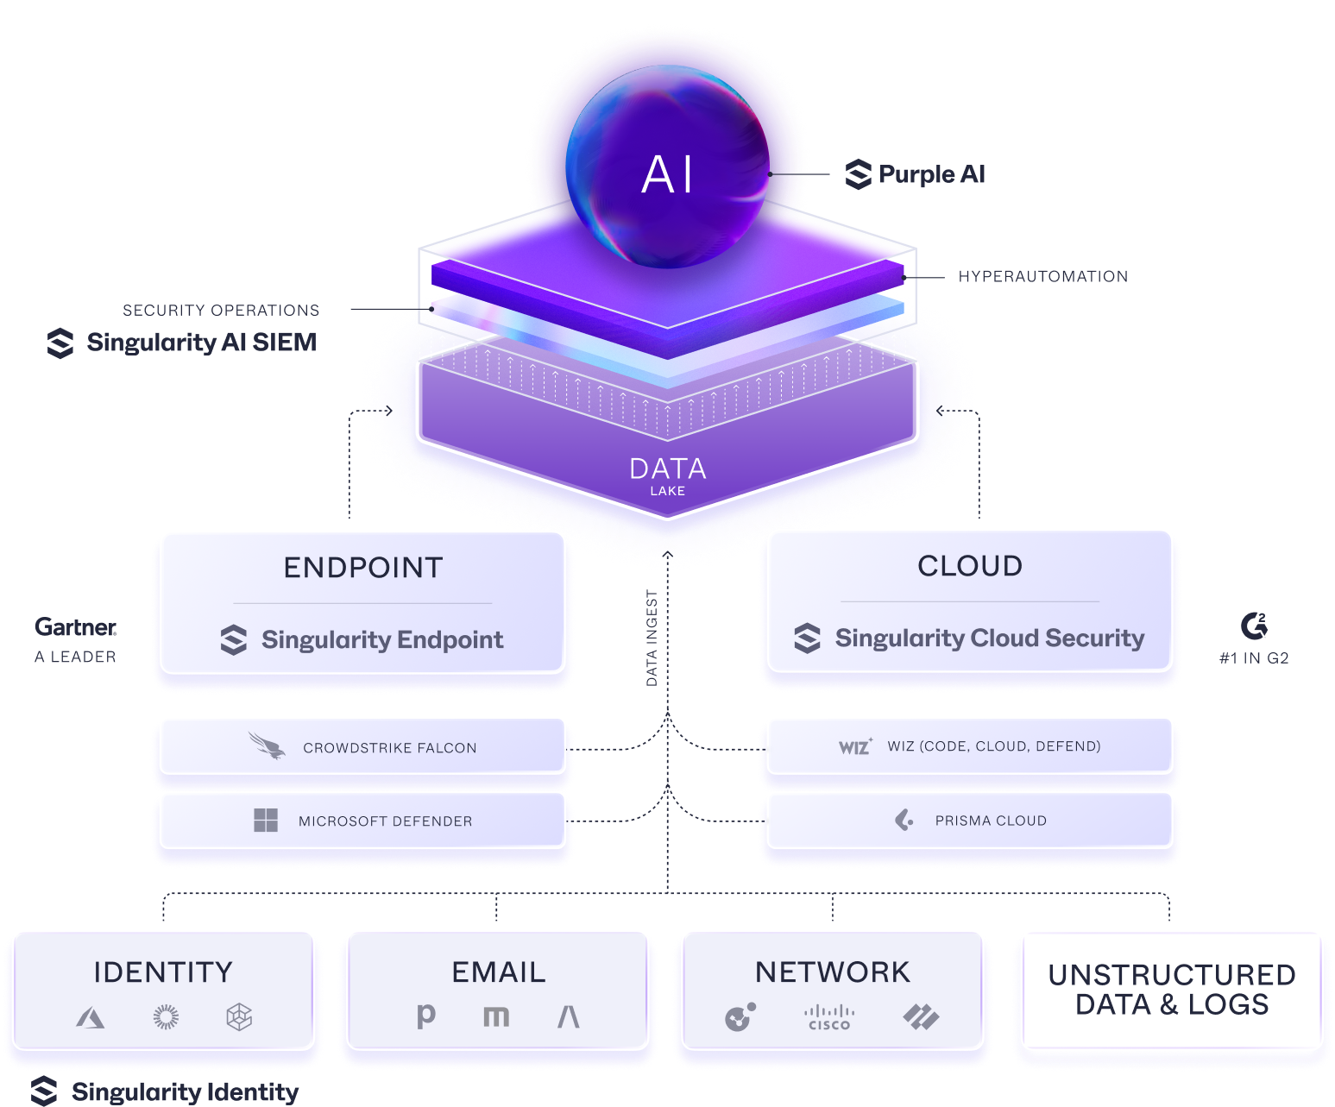
Singularity Platform
The strongest aspect of our solution is the unified platform providing protection and visibility into the endpoint, cloud environments, Identity and Active Directory, as well third- party log sources that AI SIEM can ingest.

Slide 16



Preparing for Hyperautomation
Optimize Continuously
Identify Processes
Integrate Tools
Automate Tasks

Slide 17
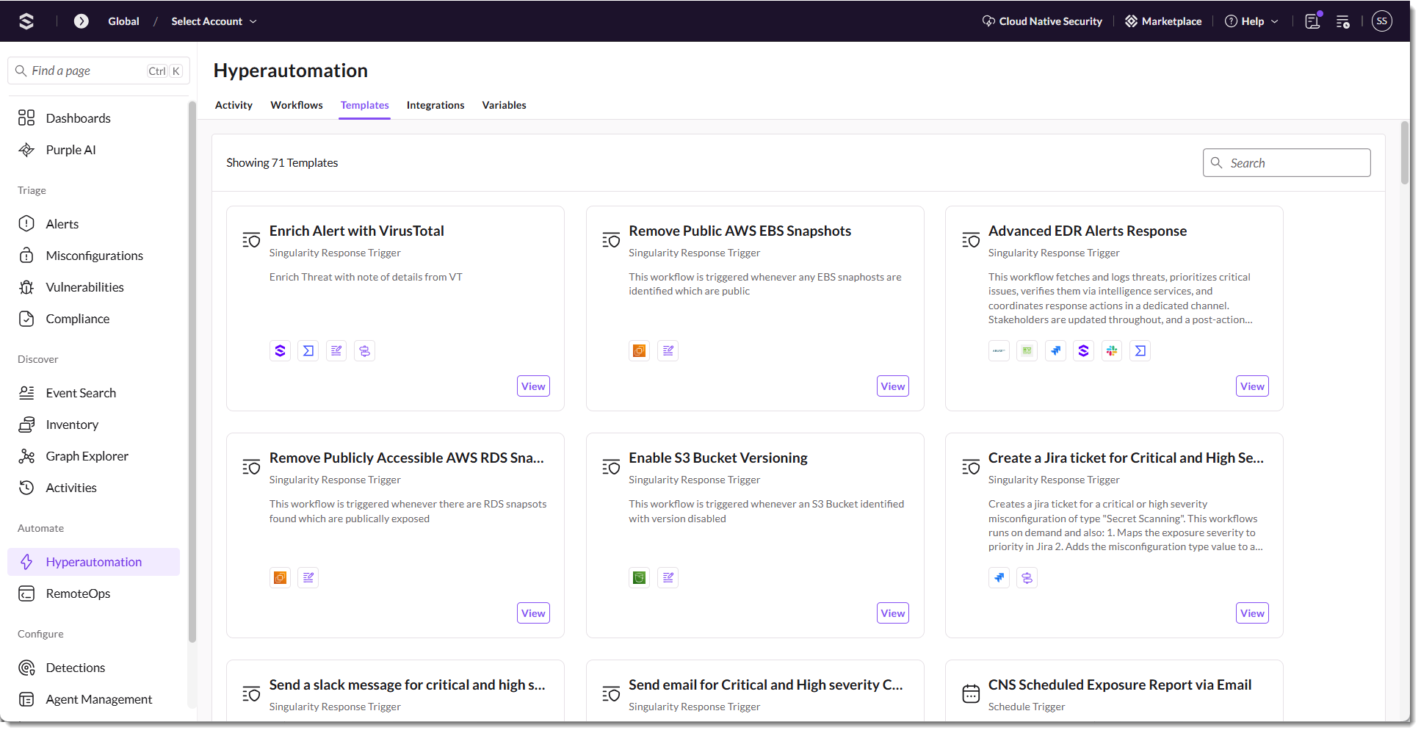
Getting Started with Hyperautomation Templates
Notes:
A workflow defines one or more actions in a process you’d like to automate.
Hyperautomation templates in Singularity™ Hyperautomation are pre-built, expert-designed workflow blueprints that help organizations quickly automate common security and IT processes. These templates address frequent use cases—such as endpoint incident response, suspicious user activity, and cloud threat remediation—by providing ready-made sequences of triggers and actions that can be customized to fit specific needs. They are accessible directly within the Hyperautomation platform, allowing users to review, use, and adapt them as starting points for building their own automated workflows. This accelerates deployment, ensures best practices, and lowers the barrier to entry for teams looking to automate and scale their operations without writing code.
Selecting Use this template copies the logic into a customizable workflow

Slide 18
Demo
Working with Templates
Notes:
Use Enrich Alert with VirusTotal as an example. Walk through basic logic, pointing out elements we’ll be speaking to:
Always starts with a trigger. Note the conditions of the trigger.
Different actions, linked together on the workflow canvas
Actions requiring configuration marked with an exclamation
Variable
Functions
Conditional branching
VT integration (we’ll look at this more closely in the Integrations section)
Integration to write results to alert notes

Slide 19
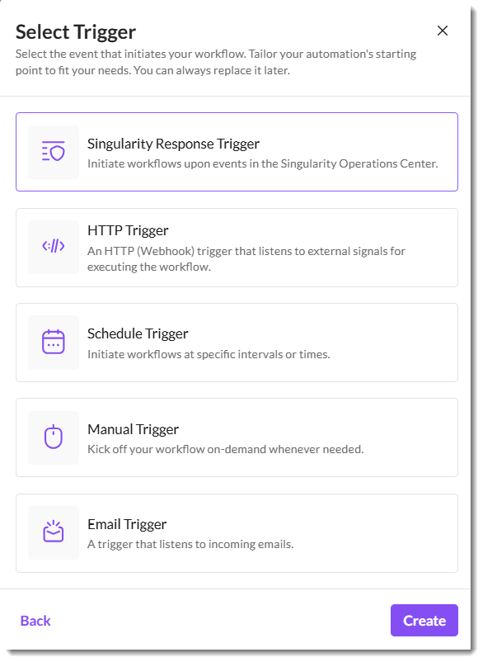
Triggers
Workflow Triggers
Workflows activate automatically based on real-time events, on a schedule, or on demand
They can respond to SentinelOne alerts and exposures, integrate with third-party tools via webhooks, process incoming emails, run on predefined schedules, or be triggered manually for immediate action.
Notes:
We’ll be looking more deeply at the Singularity Response Trigger logic in the Simple Workflow demo
Singularity Response Triggers fire off of:
Alerts
Misconfigurations
Vulnerabilities
Note that the Singularity Response Trigger can be configurated to Run Automatically or Run on Demand (we’ll see that on the next slide, as part of the analyst’s workflow). Also note that you’re not configuring an integration for viewing the exposures related to the Singularity Response Trigger. Instead, the workflow has access to the exposures within the scope of the workflow. Other actions using S1 APIs require a specific integration and connection.

Slide 20
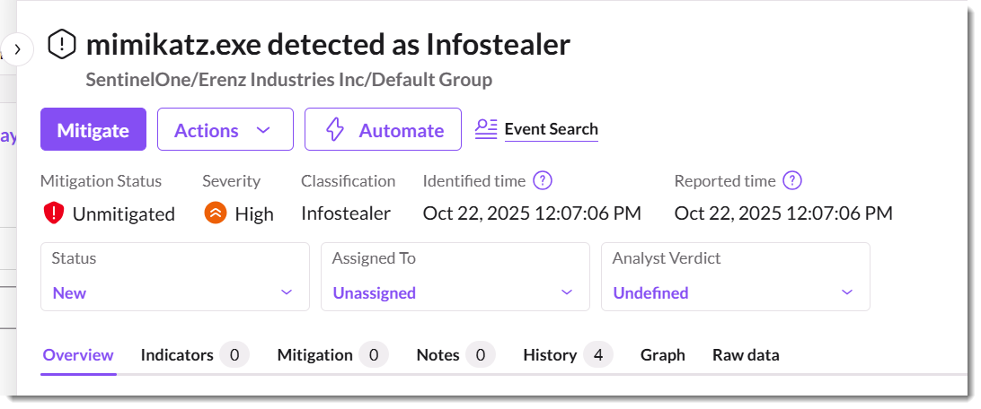
Running a Workflow from Triage
Notes:
Only workflows that are set up with a trigger type that can be initiated from an Alert—such as a "Manual Trigger" or a trigger explicitly designed to respond to alert events—will appear as options to run.

Slide 21
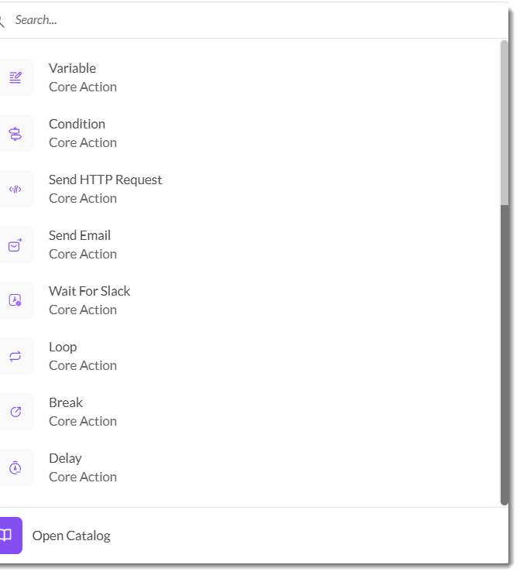
Overview of Core Actions
Adding Actions
Easily build workflows by dragging actions onto the canvas. Send HTTP requests, and emails, control logic with conditions, loops, and delays, and manage data flow using variables.

Slide 22
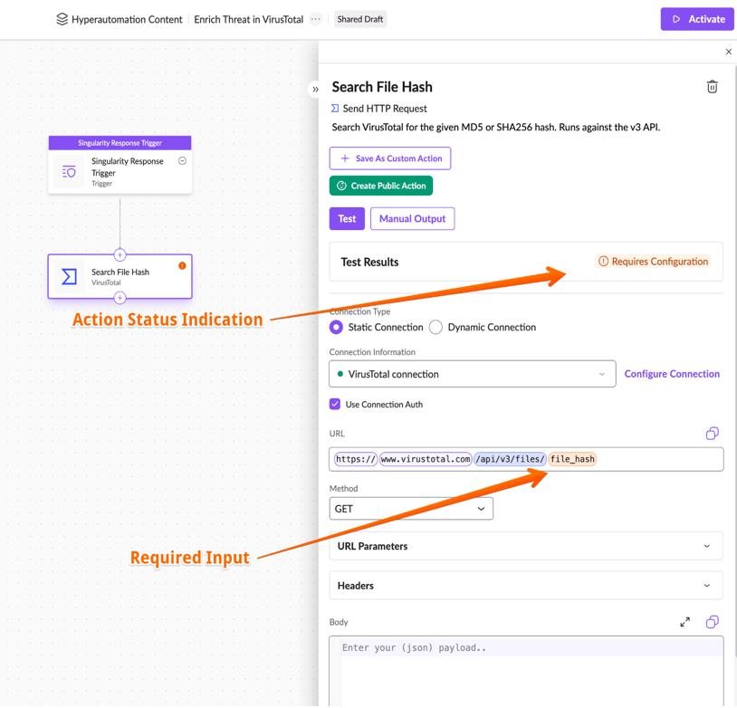
Configuring Actions
The Action Inspector
Once added to a workflow, actions are configured using the Action Inspector, which appears on the right panel.
Key parameters are highlighted for easy setup, and changes auto-save.
Testing actions is essential to ensure proper execution, a process covered coming up.

Slide 23
Demo
A Simple Workflow
Notes:
Demo
+ create Singularity Trigger for new, high-severity alert
+ send me an email
+ test both the trigger and the Send Email action and verify the results. Note, we’ll talk more about testing your actions shortly.
What if I didn’t have a new, high-severity alert handy to test this workflow? Can use synthetic/manual output.
+ Copy the alert JSON and paste it into Manual output, then rerun both the trigger and action.

Slide 24
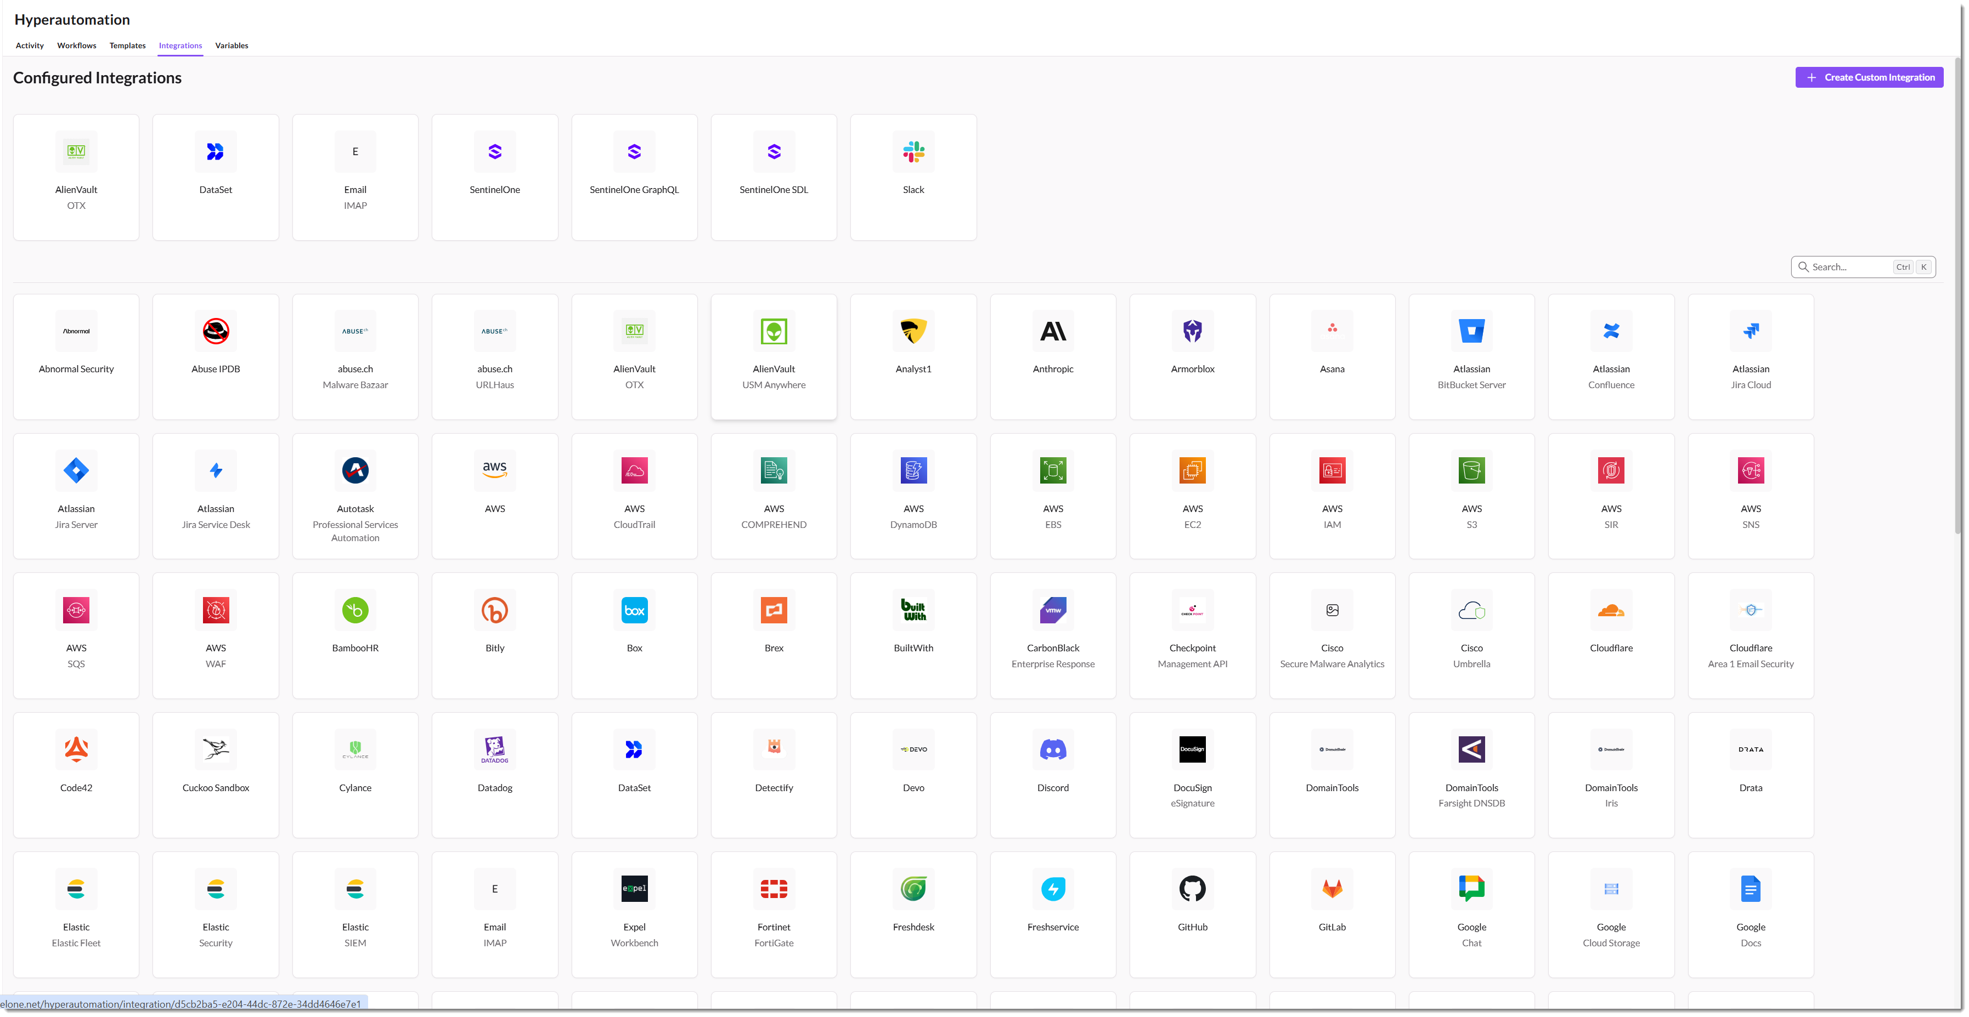
Integrations
Integrations connect workflows to third-party tools, acting as a container for both actions and connections.
Each integration is tied to a specific vendor and product.
Hyperautomation includes 150+ pre-built integrations, supports no-code API connections, and allows users to create custom integrations.

Slide 25
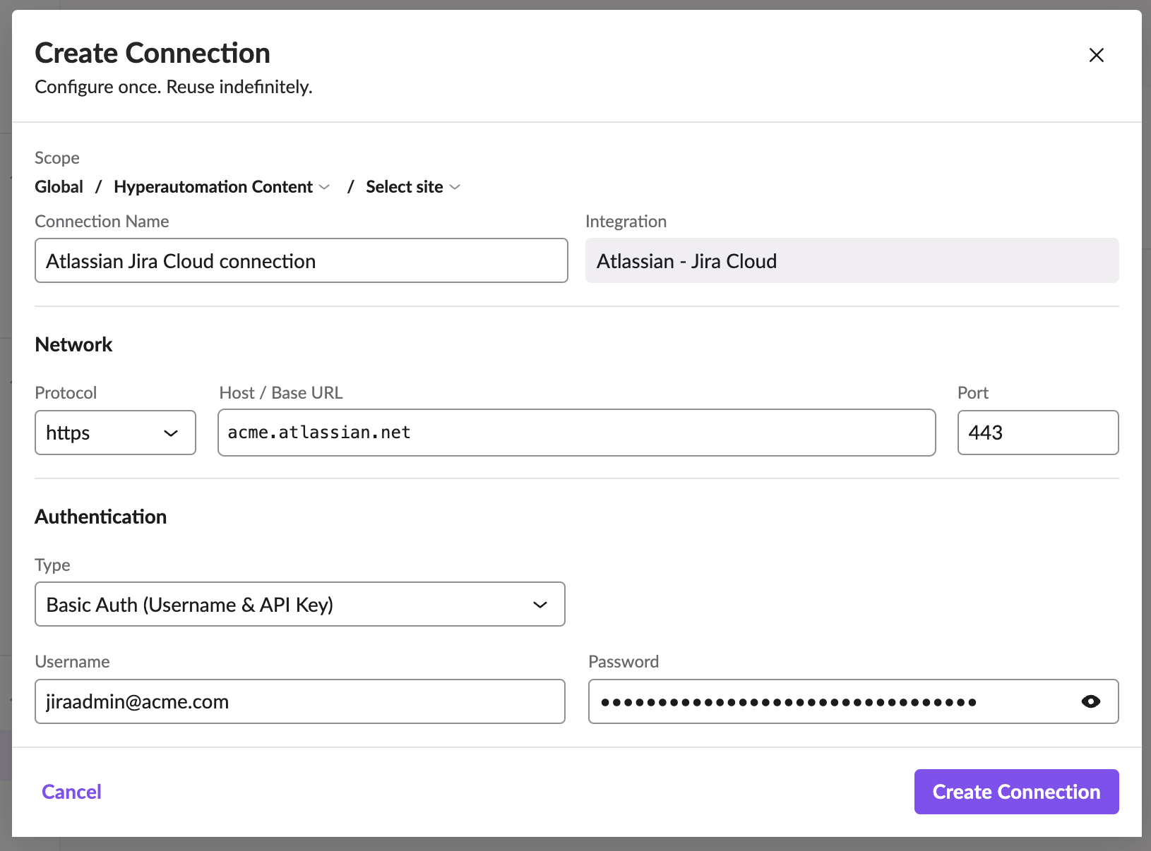
Integration Connections
Connections enable secure interaction with external systems by managing host details, authentication, and protocols.
Each integration supports multiple connections, allowing flexibility across environments. With built-in support for OAuth 2.0, API keys, and other authentication methods, connections are configured once and reused across workflows while ensuring security and privacy.

Slide 26
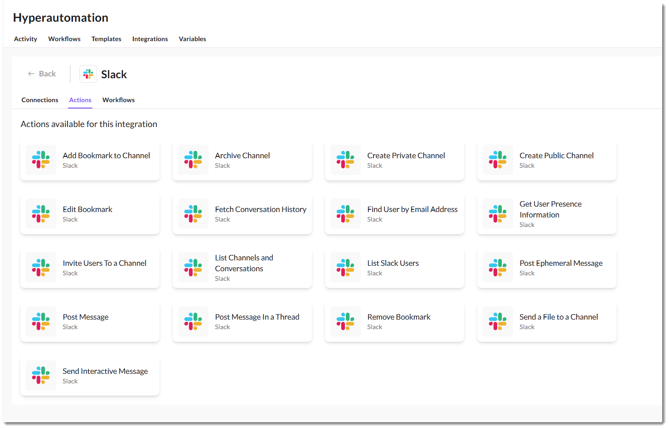
Integration Actions
Pre-configured actions are designed for seamless interaction with third-party tools.
Each integration includes built-in actions tailored to its platform, supporting operations like data retrieval, incident management, and automation tasks.
Users can also create custom actions to extend functionality and adapt workflows to specific needs.
Notes:
Might also note that you can save an action as a custom action. For example, you might create an action for a particular HTTP request and save it as a custom action so you don’t have to rebuild it from scratch if you want to use it again in another workflow.

Slide 27
Demo
Configuring Integrations
Notes:
Demo VirusTotal integration. We saw the template example earlier.
Demo GraphQL integration. Used for interacting with Unified Alert Management and XSPM (extended Security Posture Management) in the console.

Slide 28
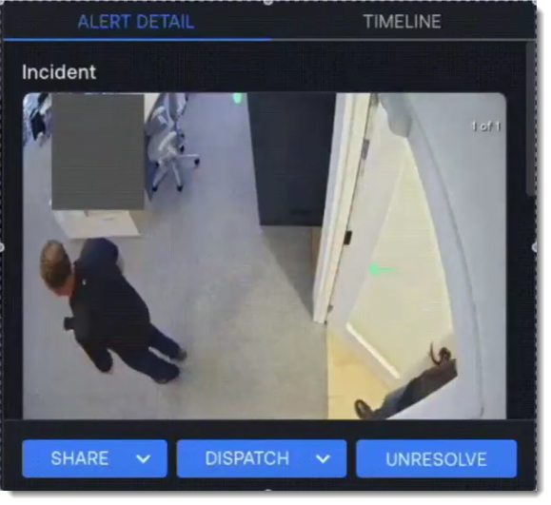
Custom Integrations
You can create custom integrations to any SaaS application for which you have an API key.
Once you create an integration, it will appear at the top of the Integrations page along with the other platforms you have configured.

Slide 29
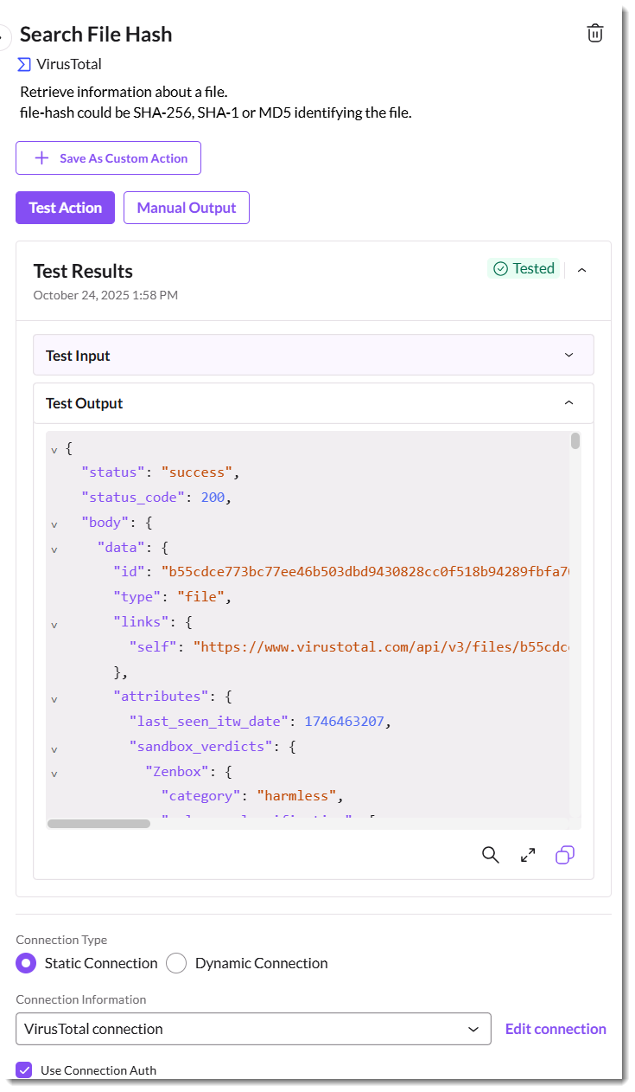
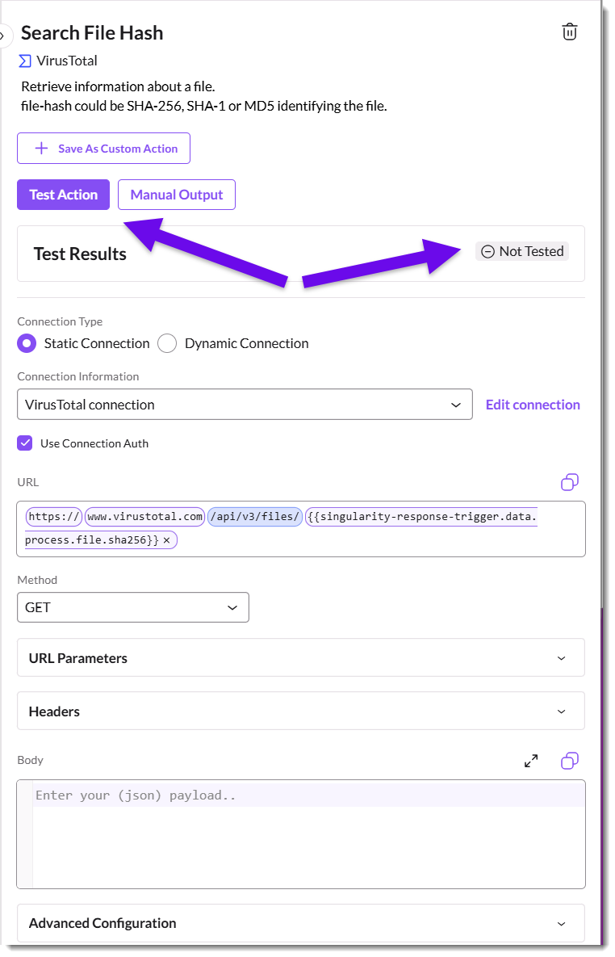
Testing As You Go
Testing actions ensures they function correctly and produce the expected output.
Run tests directly in the Action Inspector to validate configurations, debug errors, and understand output structures. Use realistic sample data or manually simulate outputs to refine workflows before execution.
Notes:
We didn’t see results in our simple email workflow until we tested them. Testing the trigger fetched the critical alert, and testing the send email action sent the email.

Slide 30
Demo
Testing Actions
Notes:
Use the Enrich Alert with Virus Total workflow to demo testing.

Slide 31
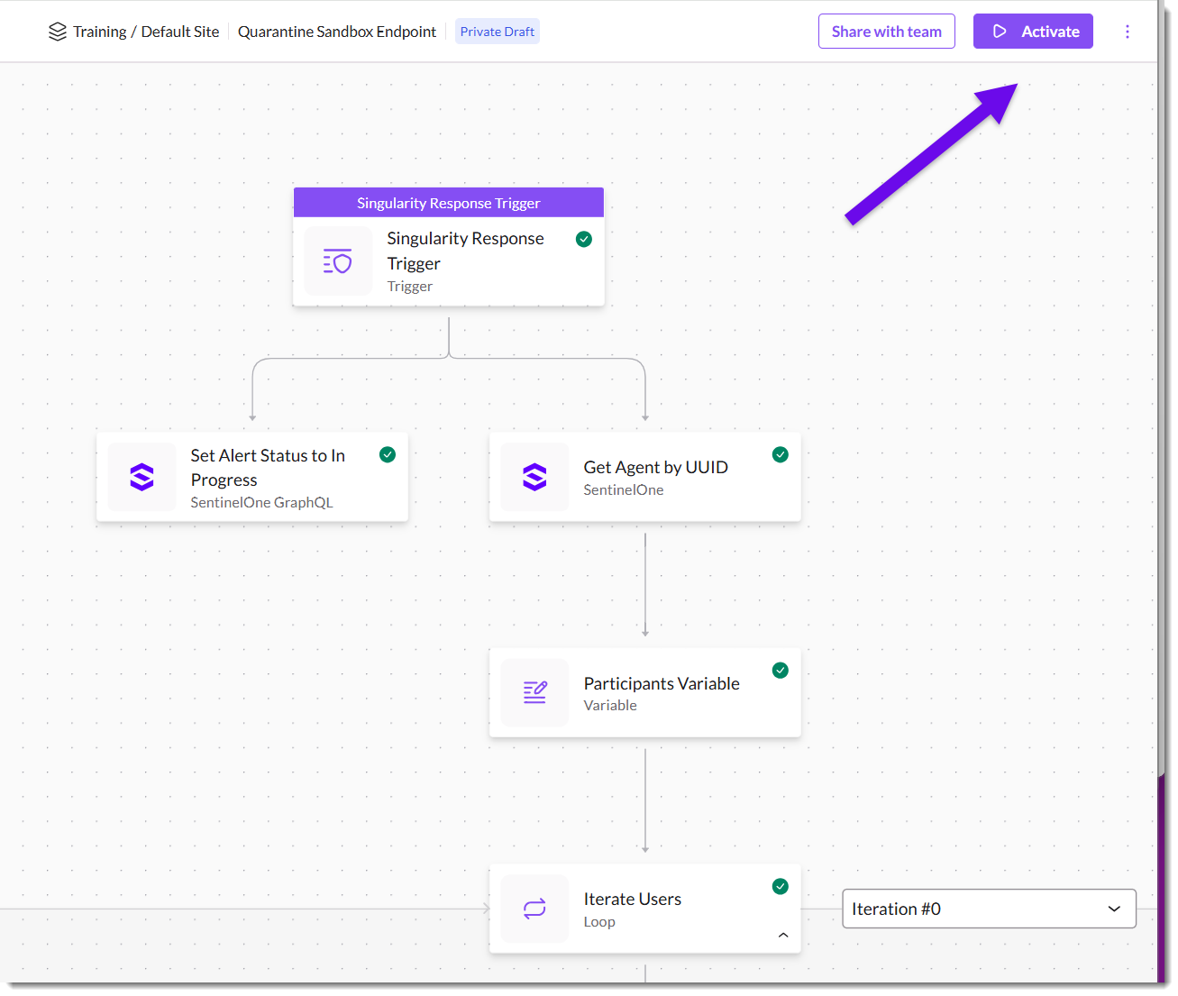
Activating A workflow
Activate workflows to make them operational, allowing them to respond to triggers and execute tasks as configured in real time.

Slide 32
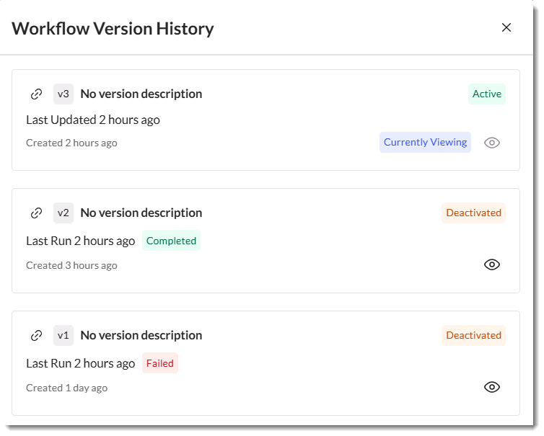
Workflow Versions
Workflows support versioning to track changes and ensure stability. Editing an active workflow creates a draft version without affecting operations.
Only one version can be active at a time, while previous versions remain accessible for rollback. Activating a new version deactivates the current one, ensuring controlled updates.

Slide 33
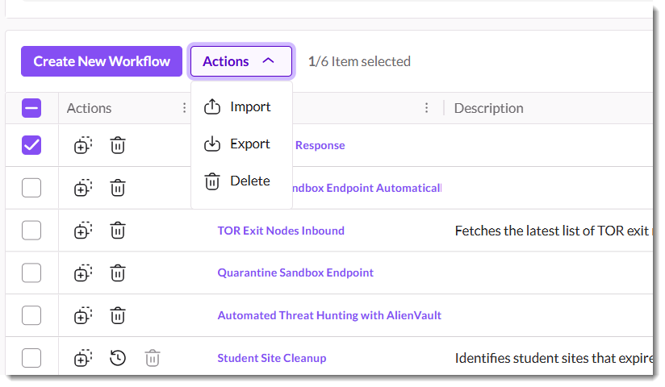
Workflow Export/Import
A workflow can be exported in the UI or via API as JSON and imported to other scopes. You can also export and import multiple workflows simultaneously as a ZIP file.
The sample workflows demonstrated later in this presentation can be downloaded here:
https://github.com/simplescripter/OneCon25
Notes:
https://github.com/simplescripter/OneCon25
A note on scoping of workflows:
Workflows created at a specific scope (e.g., Account) are only visible and usable within that scope. They do not propagate to Sites or Groups below the Account.
There are ongoing discussions and plans to improve manageability, especially for MSSPs and organizations that want to share workflows across multiple accounts or sites. However, as of now, sharing or propagating workflows from Account to Site (or from Global to Account/Site) is not natively supported; each workflow must be created or imported at the specific scope where it is needed
Other elements with this non-inheritance behavior include integrations, connections, RemoteOps scripts, Console configuration settings, and Locations.

Slide 34
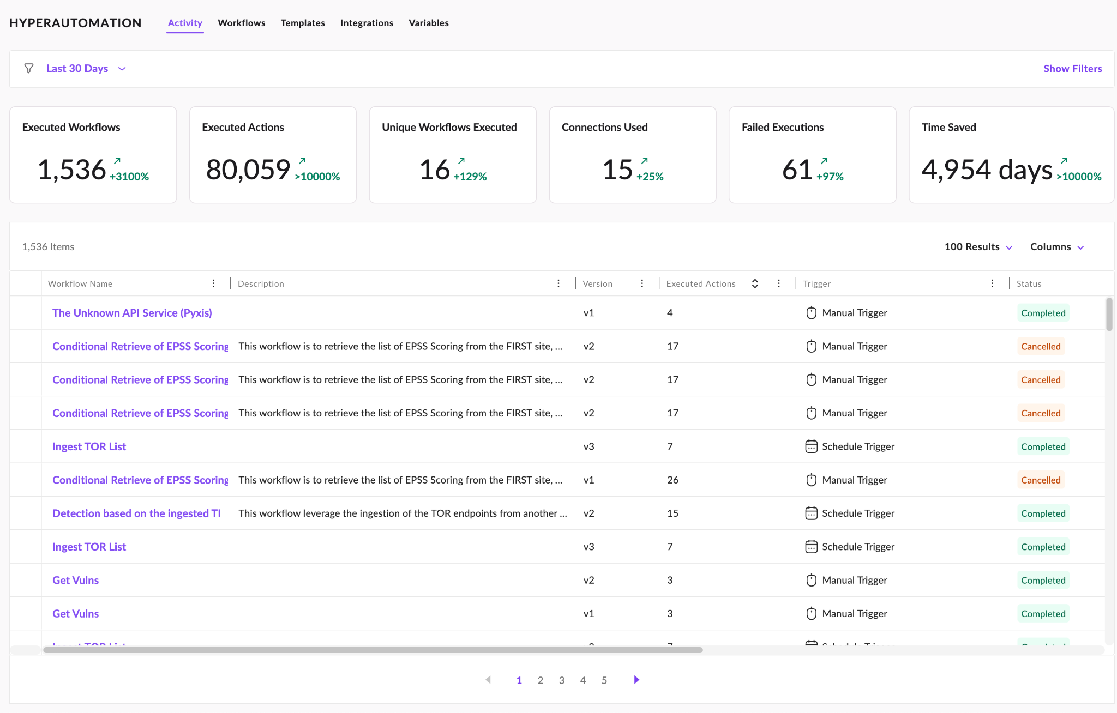
Workflow Activity
The Activity page tracks all recent workflow executions, displaying key details like workflow name, version, trigger type, and execution status.
Workflows can be filtered and sorted, with statuses including running, completed, or failed, ensuring clear visibility into operational workflows.

Slide 35
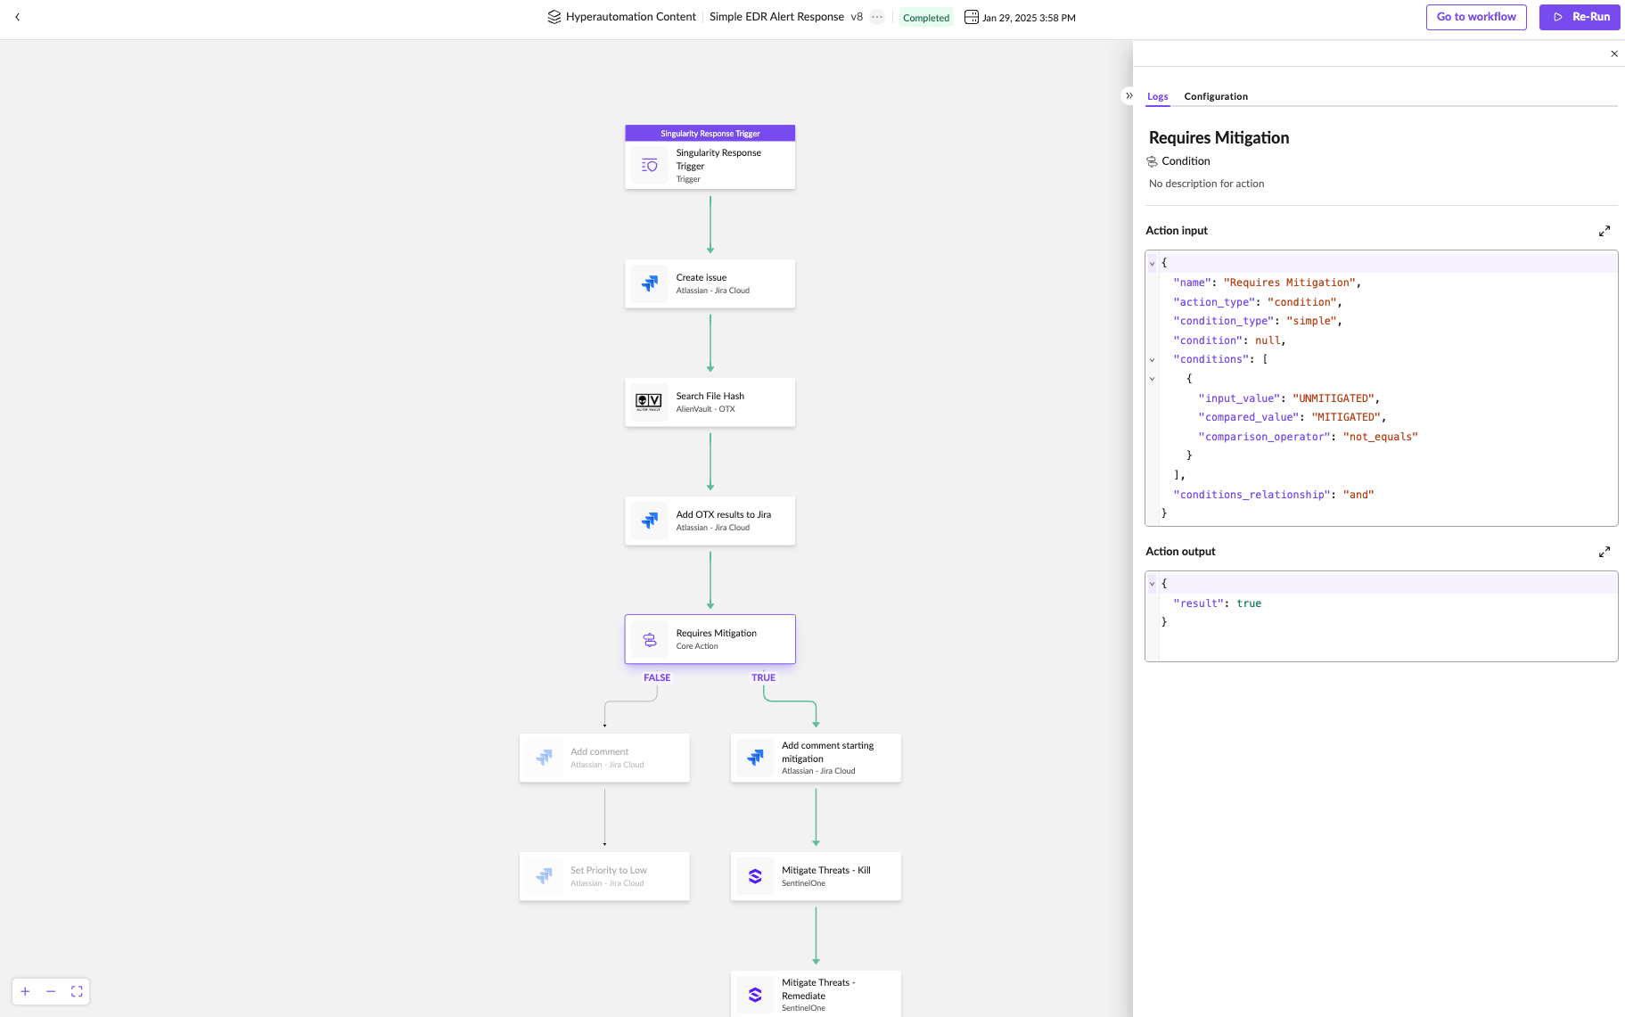
Workflow Activity
Singularity Hyperautomation
The graphical canvas allows you to inspect each action's execution, displaying real-time input and output data.
Looping actions include a selector to review individual iterations. This visual tracking is essential for debugging, ensuring accuracy, and refining workflows.

Slide 36
Demo
Workflow Admin Tasks

Slide 37
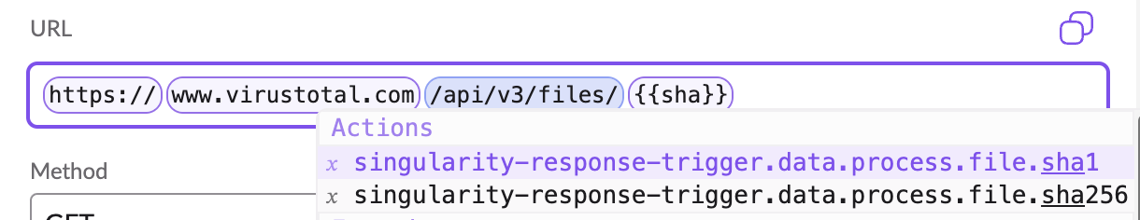
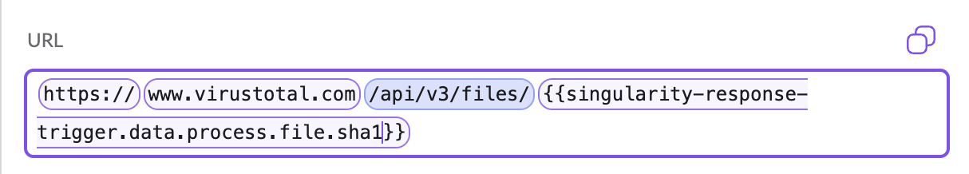
Configuring Actions - References
Actions can dynamically reference outputs from earlier steps, ensuring seamless data flow.
The Action Inspector supports auto-complete and fuzzy search for easy selection of prior action results.
Testing actions helps confirm their output schema, making references more accurate and reliable.
Notes:
Consider using https://jsonpathfinder.com/ to demonstrate JSON path structure
Also note that you can click an element in the returned JSON to copy the entire JSON path to your clipboard.
Return to the original email workflow to pull some details into the message and re-test it.

Slide 38
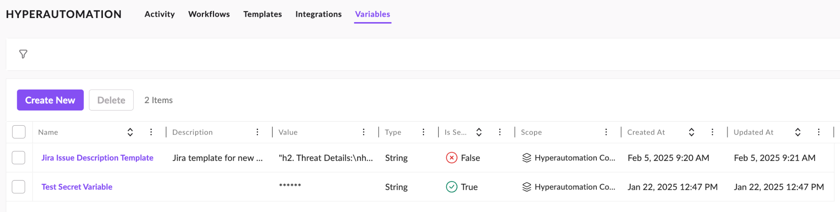
Variables
Store and share data across workflows using global variables. These variables persist beyond a single execution, enabling seamless data reuse between workflows for consistent automation and streamlined operations.
Notes:
Variables enable your Actions to dynamically reference output from earlier steps, ensuring seamless data flow. The Workflow Inspector supports auto-complete and "fuzzy" search for easy selection of prior action results.
Note: Variables are local by default. For variables to be accessible by other workflows as well, you must set them to be global.
The Variables page tracks your saved global variables. Variables store and share data both within workflows (local) and across workflows (global). These variables persist beyond a single execution, enabling great flexibility and seamless data reuse between workflows for consistent automation and streamlined operations. Variables empower advanced use of HA by defining key-value pairs to be used in Workflows, with an option to sanitize values of a given variable when inspecting executions (for example, a password or a token).
Define an empty array as []

Slide 39
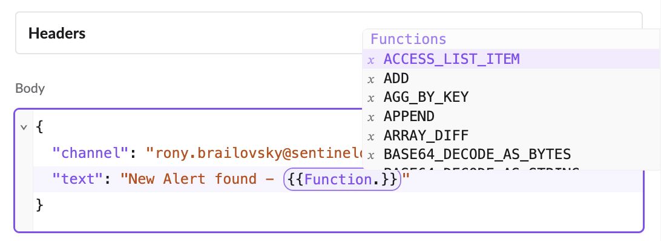
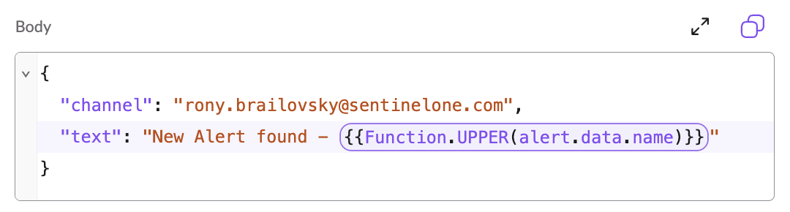
Functions
Functions are part of Actions Configuration.
Functions enable input manipulation and formatting within action configurations
https://community.sentinelone.com/s/article/000010854
Notes:
Open https://community.sentinelone.com/s/article/000010854 and talk through some examples. We’ll see several different uses for functions in the use cases section of the session, coming up next.
For Function.JQ and an introduction to JQ, see https://www.digitalocean.com/community/tutorials/how-to-transform-json-data-with-jq
Useful tool is https://jqplay.org

Slide 40
Workflow Use Cases

Slide 41
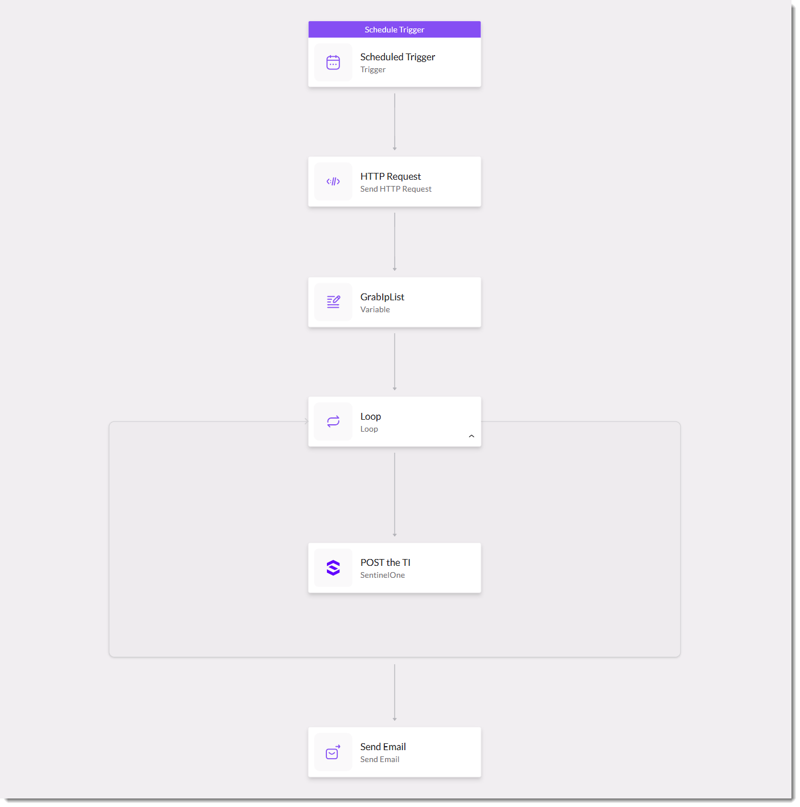
Updating Custom Threat Intelligence
This TOR Exit Nodes Inbound workflow imports public threat intel into the SentinelOne platform on a regular cadence

Slide 42
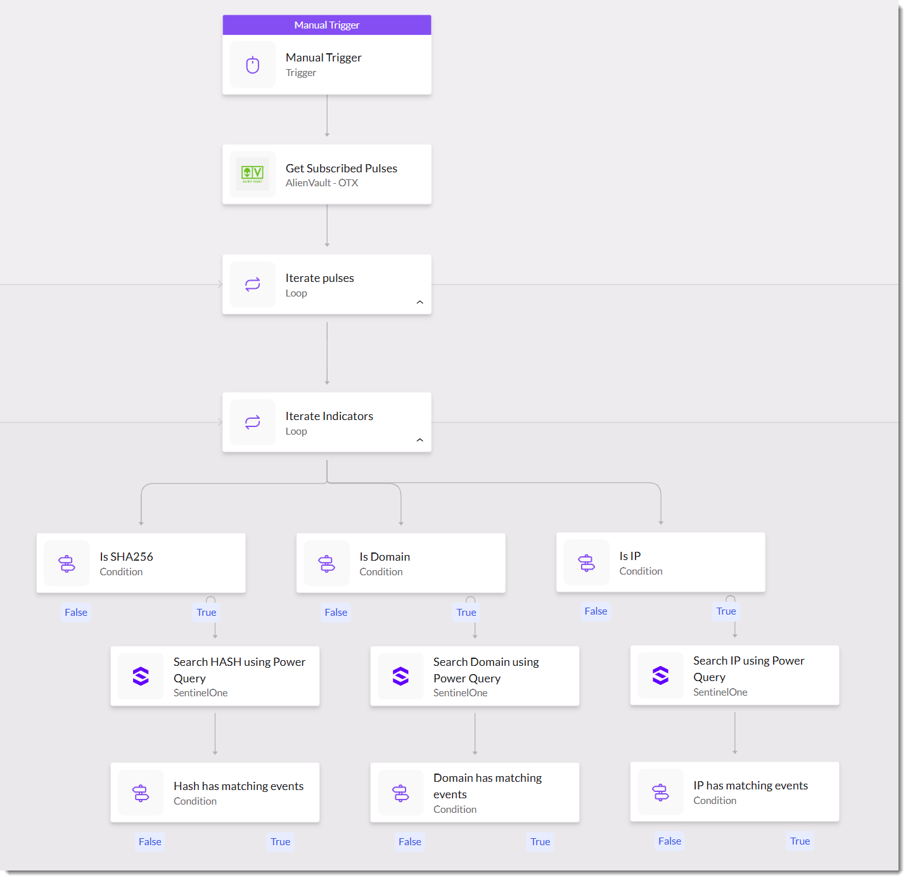
Threat Hunting
This Automated Threat Hunting with Alienvault workflow searches the Singularity Data Lake for IoCs pulled dynamically from AlienVault Pulse subscriptions
Notes:
Note that when dealing with results in a loop, the special item term is a reference to the data returned within the current iteration (in other words, “item” isn’t a reference to a key in the JSON itself; it’s used by Hyperautomation as a special term).

Slide 43
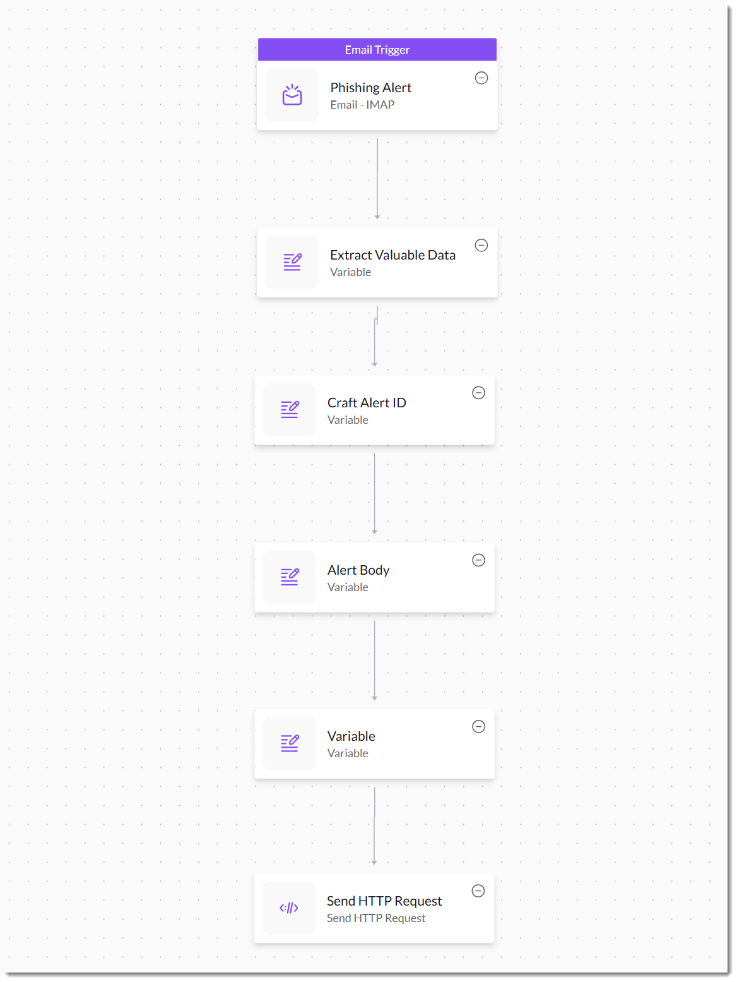
Create Ops Center Alerts for Phishing Attempts
This Phishing Alert workflow monitors a phishing inbox and generates a SentinelOne alert populated with the relevant details
Notes:
Unified Alert Management Ingest API: https://community.sentinelone.com/s/article/000009322
Function.ACCESS_LIST_ITEM accesses a list item at a specific index
Function.BASE64_DECODE_AS_BYTES: Converts a Base64 string to its byte sequence
_______________________________________________________________________________________________
regex breakdown for <(?P<url>https?:\/\/[^>\s]+)>
< > literal opening and closing brackets
( ) create a capture group
?P<url> assigns the name “url” to the capture group
https? matches both http and https
:\/\/ matches :// (escaping the forward slashes)
[ ] define a character set
^ at the start of the set means "match any character not in this set“
> means do not match the closing angle bracket.
\s means do not match any whitespace character
+ means match the preceding character (or character set) one or more times

Slide 44
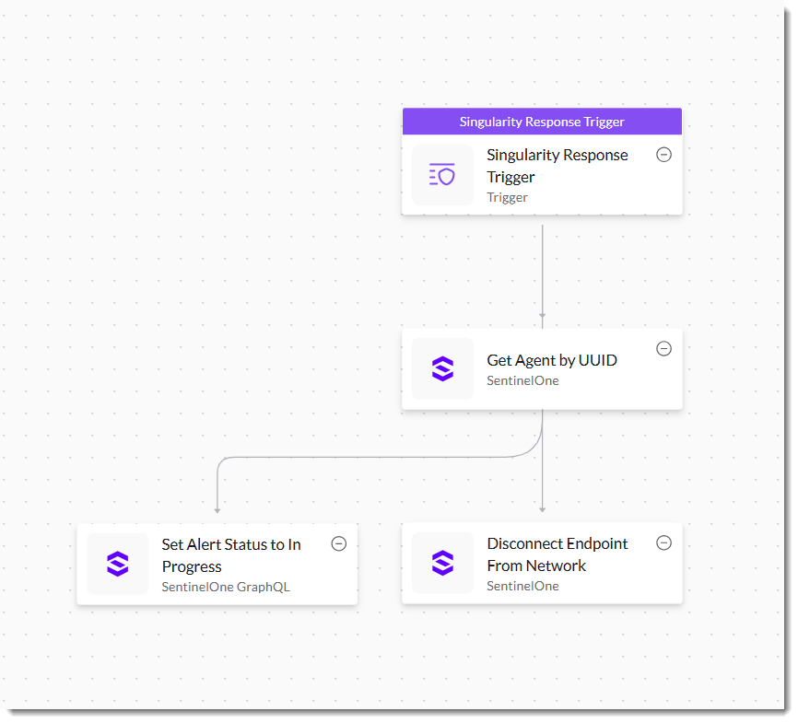
Automatically Quarantine a Compromised Endpoint
This Quarantine Sandbox Endpoint Automatically isolates an endpoint from the network if it shows signs of Windows Sandbox abuse

Slide 45
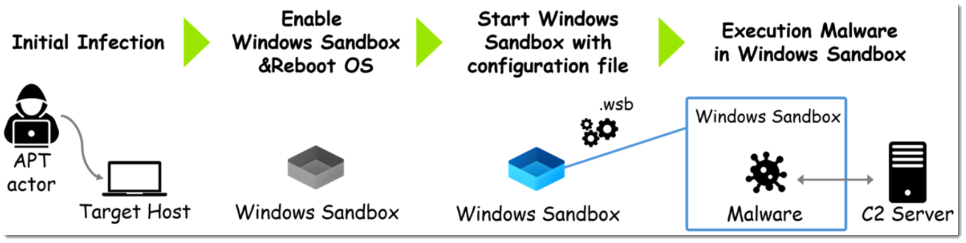
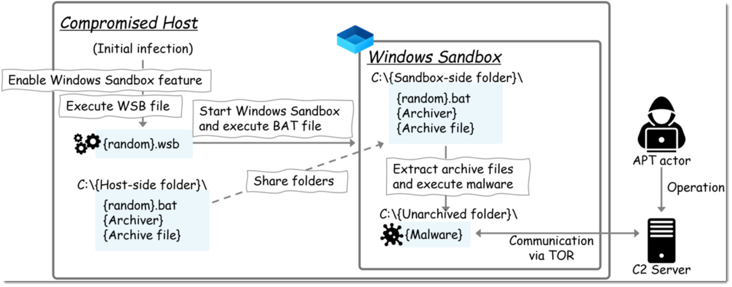
Windows Sandbox Abuse
https://blog-en.itochuci.co.jp/entry/2025/03/12/140000
Notes:
From ITOCHU, a Japanese cybersecurity research company

Slide 46
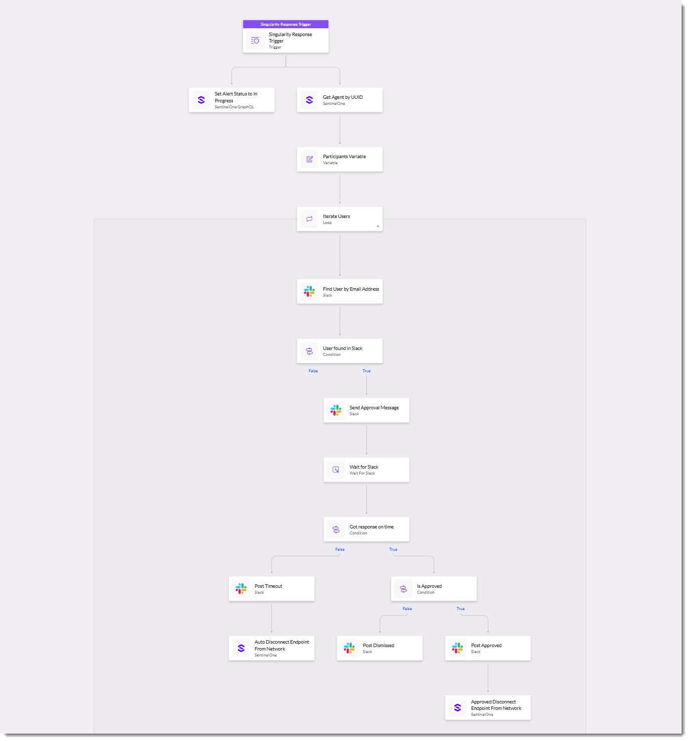
Prompt Analyst to Quarantine a Compromised Endpoint
This Quarantine Sandbox Endpoint workflow builds on the previous use case by prompting the analyst in Slack to approve or disapprove the quarantine operation

Slide 47


Thank You

